Slide 1
CUSTOMER CHURN
Dorcas Ndambuki

Slide 2
HIGHLIGHTS
Business Understanding
Data Understanding
Data Cleaning
Primary Results
Modelling
Recommendations

Slide 3
BUSINESS UNDERSTANDING
SyriaTel is losing revenue as customers move to competitors.
This costs more than retaining an existing or gaining a new one.
We want to identify customers likely tot churn so that:
We can target them with retention offers and incentives.
Objective: To build a predictive classification model to identify customers likely to churn.

Slide 4
DATA UNDERSTANDING
Data sourced from:
SyriaTel Customer Churn Dataset from:
Link: https://www.kaggle.com/datasets/becksddf/churn-in-telecoms-dataset
Has 3,333 rows and 20 features
Target variable: Customer Churn (True/False)
Features: total day minutes, customer service calls, international plan, voice mail plan, total day charge

Slide 5
DATA CLEANING
There were no:
Missing values.
Duplicated values.

Slide 6
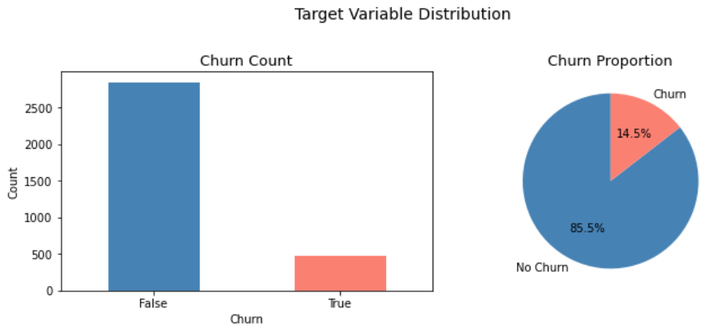
PRIMARY RESULTS
More customers did not churn as compared to those who did.

Slide 7
MODELLING
For this project, we used:
Logistic Regression
Decision Tree
Random Forest Classifier.
Metric for assessing success: Recall

Slide 8
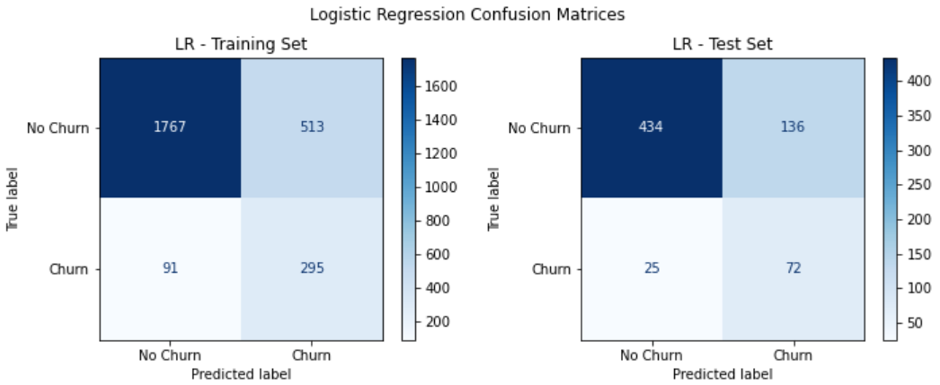
LOGISTIC REGRESSION

Slide 9
DECISION TREE
Test Recall: 0.722: identifies 72% of actual churners on unseen data
Overfit gap: 0.133: train recall (0.855) is much higher than test recall (0.722), showing the model memorizes training data more than Logistic Regression did
ROC-AUC: 0.803: Slightly lower than Logistic Regression (0.828)

Slide 10
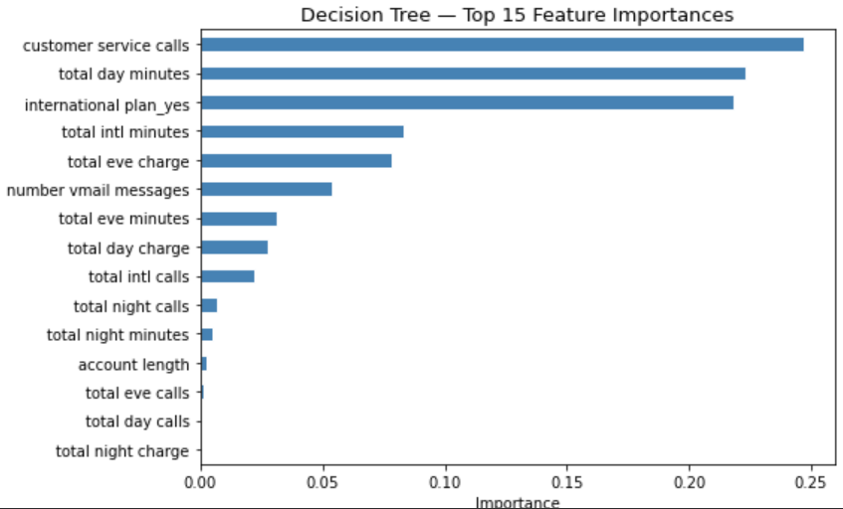
TOP FEATURES AS PER DECISION TREE

Slide 11
RANDOM FOREST CLASSIFIER
Test recall (0.701) and has the largest overfit gap (0.208).
Training ROC-AUC of 1.000:
Confirms it is memorizing training data rather than learning generalizable patterns.

Slide 12
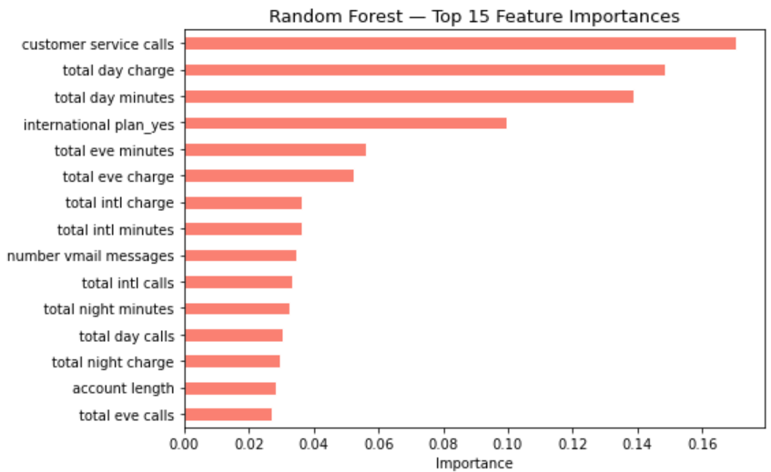
TOP FEATURES AS PER RANDOM FOREST CLASSIFIER

Slide 13
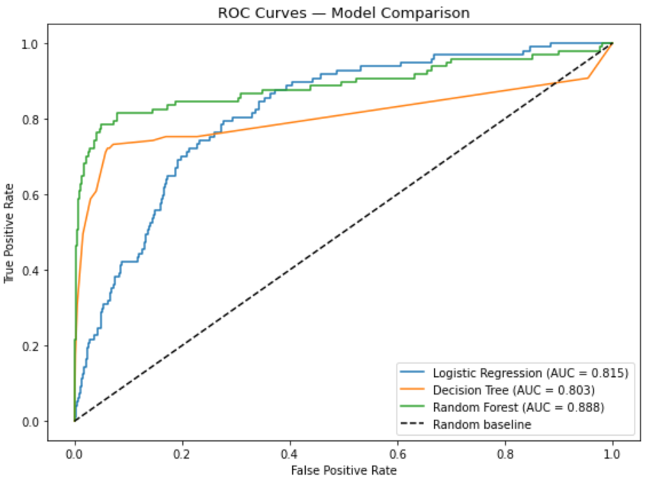
ROC CURVE COMPARISON

Slide 14
CONCLUSION - MODEL
Logistic Regression selected as the final model because it:
Achieved the highest test recall (74.2%).
Lowest overfit gap (0.022)

Slide 15
RECOMMENDATIONS
Deploy the model to score customers monthly.
Intervene after the 2nd customer service call.
Offer plan reviews to high day-charge customers.
Investigate the international plan experience.

Slide 16


